Slide 1

Seminar on AI & Technology Innovation
Dr James CHAU
29 July – 31 July 2024

Slide 2
Topic
Artificial Intelligence of Things (AIoT)

Slide 3
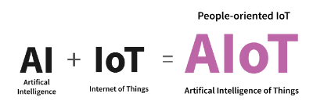
AIoT
AIoT is the combination of AI technologies with IoT to achieve more efficient IoT applications and decision-making processes
E.g. Face recognition for authorization
Its goals is to balance the performance, price and the power consumption of the IoT devices
Main characteristics
High data volume
High latency sensitivity
High energy efficiency
Data privacy

Slide 4
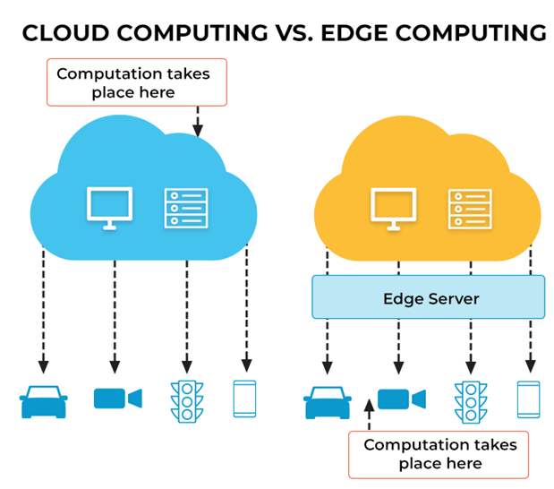
Key features
It keeps the data at the edge device
It has a powerful processing capability but limited resource
It can collaborate with the other edge devices through the local area network

Slide 5
TinyML model
It reduces the number of parameters of a deep learning model so that the model can be executed by the edge devices
Process: quantization, pruning, layer fusion, etc.
It has been promoted by tinyml.org
Available tool: TensorFlow Lite, emlearn, EmbML, TinyMLgen, FANN-on-MCU, m2cgen, etc.
Available IoT device: Arduino Nano 33 BLE Sense, SparkFun Edge, STM32F746 Discovery Kit, Adafruit EdgeBadge, Espressif ESP32-DevKitC, etc.

Slide 6

Project: Tinyml Fomo
Face mask detection

Slide 7
Project: Sensorless predictive maintenance system
Aim to protect electric motor systems
https://www.renesas.com/us/en/video/embedded-ai-tinyml-based-sensorless-predictive-maintenance-electric-motor-systems

Slide 8
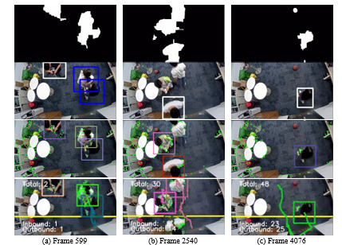
Project: Vision Based Pedestrian Counting System
Counting people in the monitoring area
https://youtu.be/ZdZS4L0YBZc?list=PLPr6cEMVZ32j9_py0GPFKZ0NrKDtZETL0

